Slide 1
LACE: A tool to predict Readmission within 30 days post-Discharge.
Carter Hoffman and
Antenor Vilceus

Slide 2
Objectives
Background
What is LACE?
WHY do we need LACE
Current present state of readmission within 30 days post- discharge.
The consequences of inertia(quality and financial)
LACE: The Solution
Model Description
Relation of the Model to our Institution
Role and sponsorship of the LACE Project

Slide 3
Background
Readmission to hospital are adverse patient outcomes that are serious, common and costly.
Predicting accurately the risk of poor outcomes after hospital discharge would allow health care workers to intervene on patients who are at highest risk of poor post-discharge outcomes.
CMS is penalizing hospitals with relatively high rates of readmission or rewarding hospitals with relatively low expected rate
Notes:
Carl van Walraven MD, Irfan A. Dhalla MD, Chaim Bell MD, Edward Etchells MD, Ian G. Stiell MD, Kelly Zarnke MD, Peter C. Austin PhD, Alan J. Forster MD
Derivation and validation of an index to predict early death or unplanned readmission after discharge from hospital to the community
CMAJ•APRIL 6, 2010 • 182(6) © 2010 Canadian Medical Association or its licensors
551

Slide 4

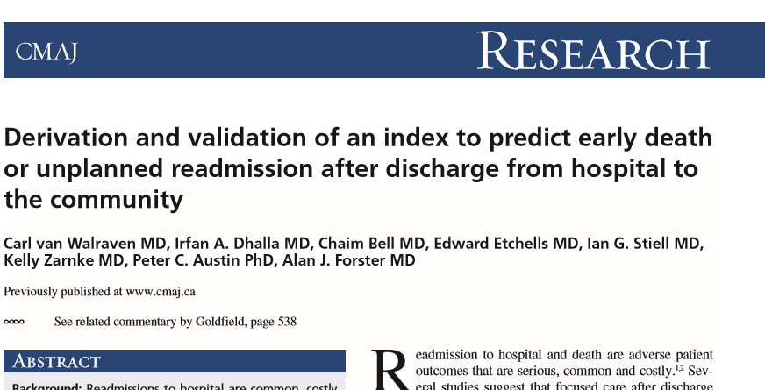
LACE
Notes:
Carl van Walraven MD, Irfan A. Dhalla MD, Chaim Bell MD, Edward Etchells MD, Ian G. Stiell MD, Kelly Zarnke MD, Peter C. Austin PhD, Alan J. Forster MD
Derivation and validation of an index to predict early death or unplanned readmission after discharge from hospital to the community
CMAJ•APRIL 6, 2010 • 182(6) © 2010 Canadian Medical Association or its licensors
LACE was derived from the work of a group of Canadian researchers published in 2010.

Slide 5
What is LACE
Method of Prediction Readmission within 30 days.
Length of stay:
Admission through the Emergency room
Determine the acuity of the illness.
Comorbidities
Stroke and Asthma
Prior Visits to ED in the past 6 months
Notes:
This model was first published in 2010 by Carl van Walraven MD, Irfan A. Dhalla MD, Chaim Bell MD, Edward Etchells MD, Ian G. Stiell MD, Kelly Zarnke MD, Peter C. Austin PhD, Alan J. Forster MD
Derivation and validation of an index to predict early death or unplanned readmission after discharge from hospital to the community
CMAJ•APRIL 6, 2010 • 182(6) © 2010 Canadian Medical Association or its licensors
551
LACE Risk Score is determined by 4 variables: Length of stay, Admission through the Emergency room, Comorbities( stroke and asthma and prior visit to ED

Slide 6
Why do we need to change?
Regulatory Requirement
Quality Improvement
Financial
Strategic Alignment
Learning Organization
Notes:
Regulatory Requirement: CMS is penalizing healthcare organizations with above average readmission rate and rewarding those with a lower rate.
Quality Improvement : Higher readmission rate reflects poor quality care. In addition, LACE fits nicely within our strategic plan and on-going improvement projects.
Financial: The new payment model dictates that we use limited resources wisely. A readmission is a lost opportunity to serve our patient as well to advance our strategic goal and objectives.
Learning organization: We are always in pursuit of excellence.

Slide 7
State of Our Healthcare organization
Patient Population: 34532
Readmission :5169 (14.96%)
National Average is worse. We can improve and must improve.

Slide 8
The consequence of Inertia.
Our vision: To insure that our patients have the best care and health possible
Our mission: To improve health and health care of our population.
In alignment with our strategy, we have to improve continuously.
Resources are scarce. Resources we have obtained from CMS afford us to continue to expand and improve care for our patients.
Notes:
Build the connection between inaction and the future state with a focus on building the emotional need for change. Connect current problems to likely / plausible future consequences.

Slide 9
LACE: The Solution
LACE Score is a clinically useful index to quantify the risk of unplanned readmission among patients discharged from our organization.
We fit a logistic regression model on the LACE variables as a way to predict readmission.
Notes:
Explain the solution at a high level before going into detail.
Skipping the high level and jumping straight to the detail is the second most frequent analyst presentation mistake I see. Give your audience the big picture first so they can better understand and relate to the component parts. This will save you from interruptions and increase their understanding.
The bulk of your presentation should focus on the solution (this section plus the next two)

Slide 10
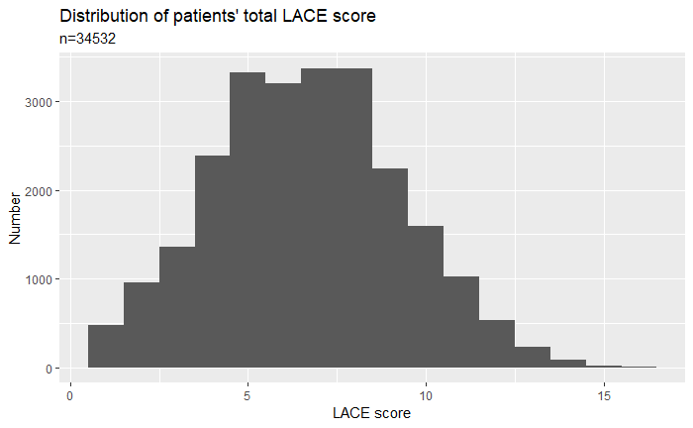
LACE Score Distribution of our patients.

Slide 11
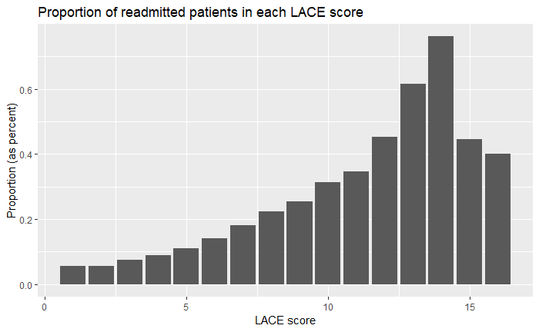
Observed Readmission of each LACE Score.

Slide 12
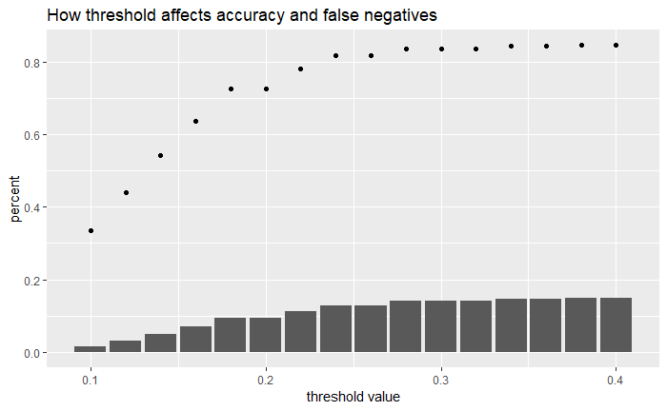
Threshold

Slide 13
Specificity and Sensitivity
Specificity: 78%
Sensitivity: 40%
Accuracy: 72%
 | True Negative | True Positive
Predicted negative | 3975 | 566
Predicted positive | 1090 | 377
Notes:
Specificity: 78% TN/TN+FP
Sensitivity: 40% TP/TP+FN
Accuracy: 72% TN+TP/total

Slide 14
Relate the Organization
Our Pilot project demonstrates that we can continue on the improvement continuum
Next step: Full implementation
On-going evaluation
Sustainable because it is part of our strategic plan
Our goal in the next 12 months is to reduce readmission by 15% from 14.96% to 12.72%.

Slide 15
Your Role / Sponsorship
Build active engagement
Full participation of our entire community
We believe LACE continue to set us apart from our competitors.
Pilot: Successful
We consider this project as an investment in our patients and our organization.
Notes:
Our small pilot Of LACE have been very successful. Our leadership is fully committed to implement LACE because of alignment with our strategic plan. We will commit the resources necessary to implement LACE but also to Sustain it.
End with action!
Specifically detail what you need your audience to do in order to make this effort a success.
Think of this as the positive benefits that offset the negative consequences you highlight earlier.
Leave your audience with a clear sense of what they need to do individually to drive success when the leave the room.

